Slide 1


Upshot from Dayton: Found in Translation
Ranking Arabic Documents with Machine Learning

Slide 2
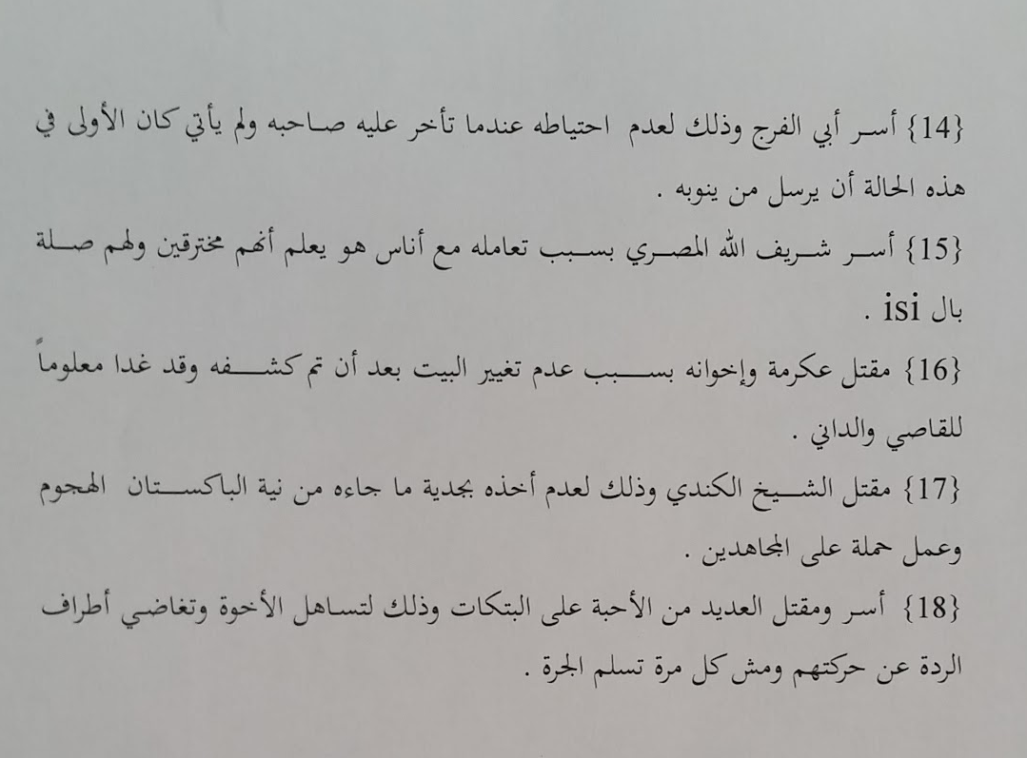
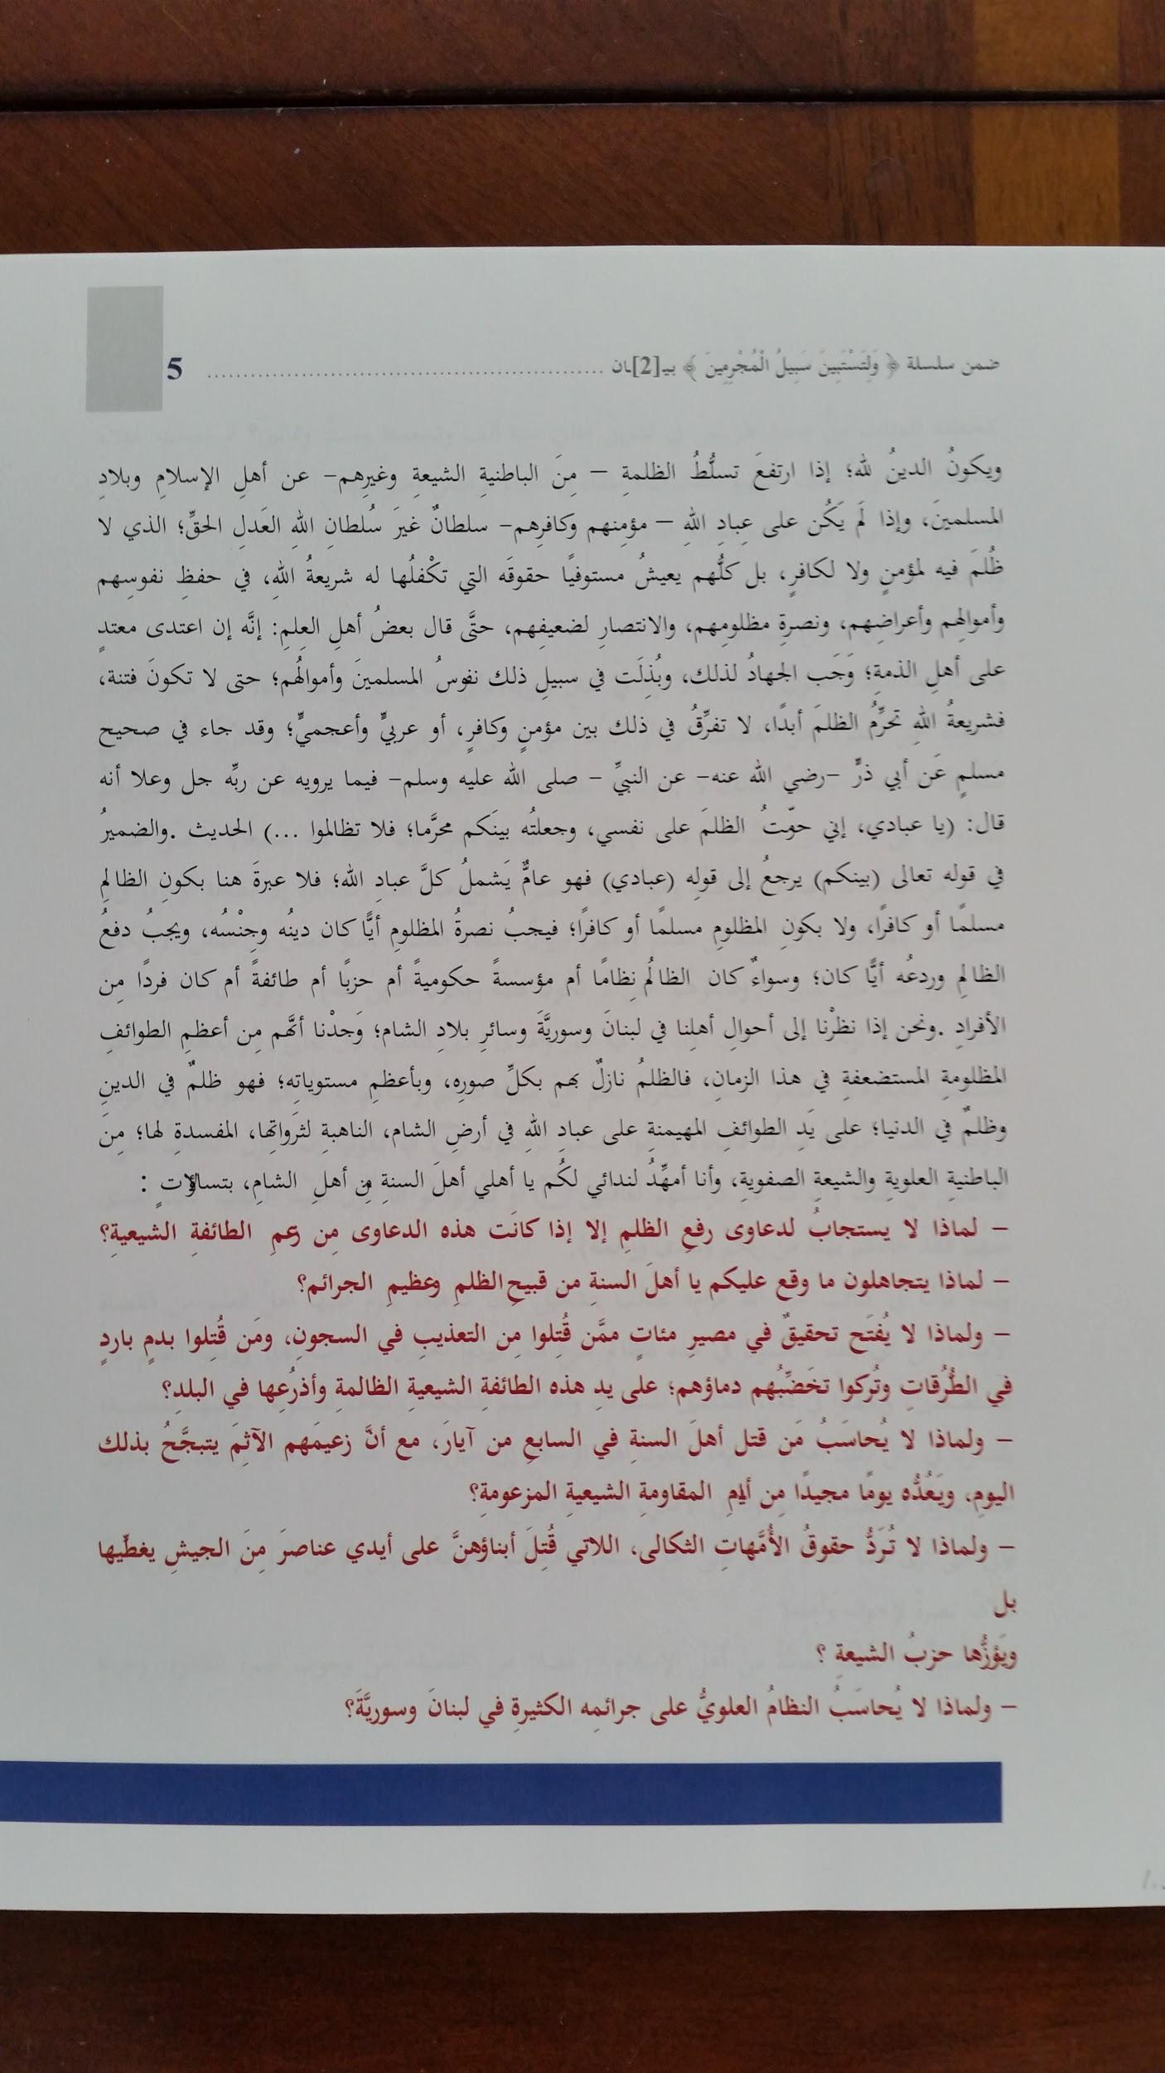
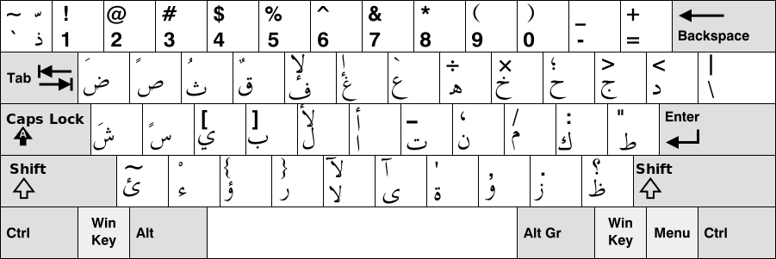
28 Letter Alphabet
Logical structure (nouns and verbs) similar to English
Written and read from right to left.
Written in cursive, making text recognition challenging.
Notes:
The main challenge with translation in being able to convert cursive images to recognized text. At that point, it can be translated with Google Translate. The Google Translate API can be used to develop a web app. This is straight forward and feasible. We decided to look at the mission and think about why this translation would be important.

Slide 3
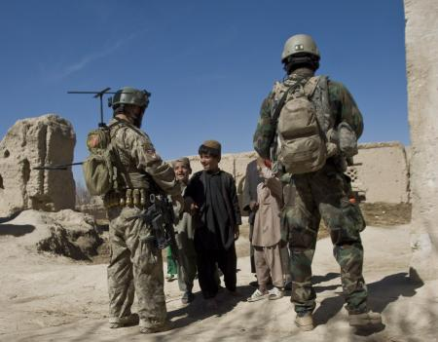
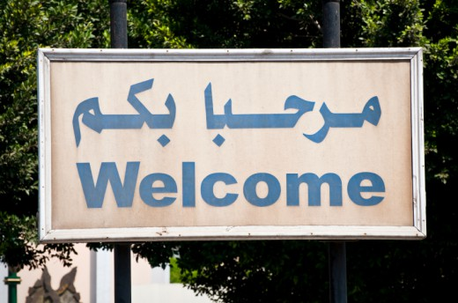
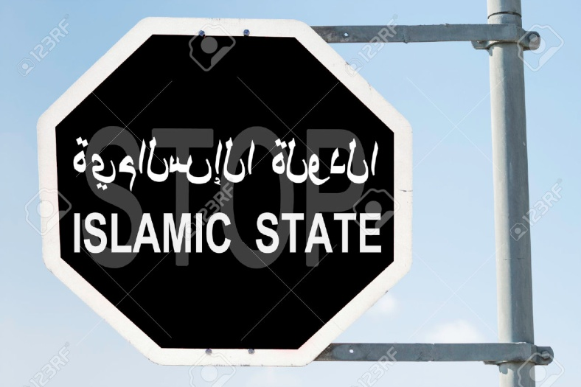
Conops
Understand the value of the document
Limited Interpreters - upshoot documents that have urgent relevance
Mobile app translation is nice to have
Notes:
The new challenges become, how do we determine if a document should be interpreted? The software architecture has to support a mobile app user interface.

Slide 4


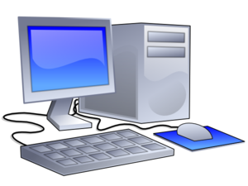

Architecture Design
Command Center with Interpreter
Image
Cache
Translate
Image Parser
Search DB

Slide 5
User Interface
Notes:
Carla has a demonstration of the user interface.

Slide 6
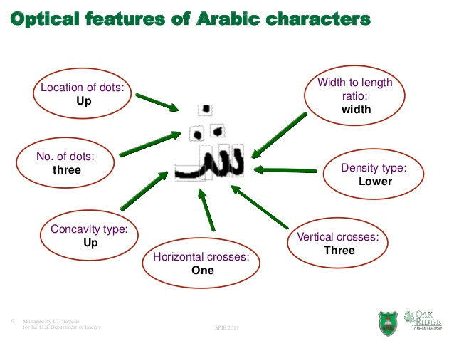
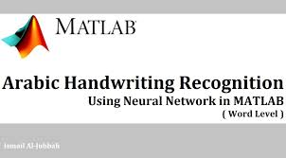
Demonstrate Image Parser
Notes:
Jun to demonstrate something.

Slide 7
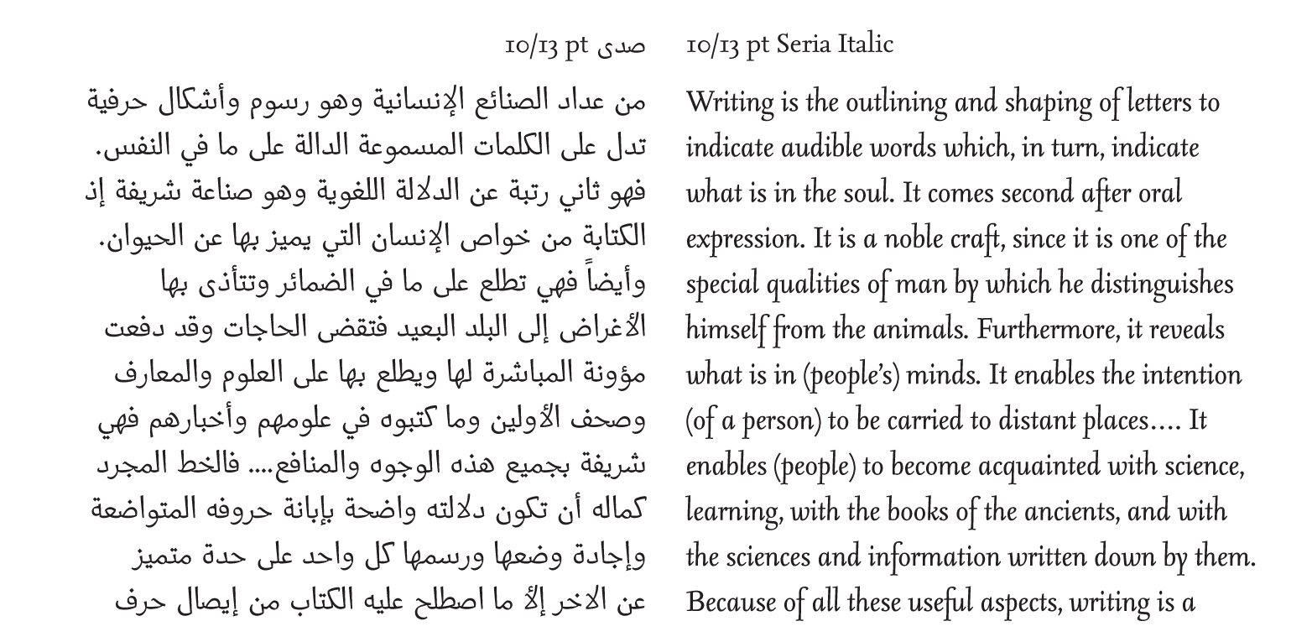
Problem Statement
Given a document photo, what other documents is it like?
Should someone translate it?

Slide 8
Limitations and Assumption
Limitations:
Small time and memory constraints (mobile computer)
Limited connectivity to central database
Limited central intelligence about documents in other language
Assume:
Documents can be parsed into words
Words can be mapped to their English word/words (Dictionary lookup)
English words can be counted to create a histogram of words (BOW)

Slide 9
Demonstrate Classifier Solution
Key Idea:
Convert document to a simple representation in native language
Represent documents as bag of words (BOW) histograms
This allows train a classifier(s) using corpus of labeled documents in native language (HUGE CORPUS FROM NATIVE INTELLIGENCE)
Classifiers quickly tell what kind of document it is like.
Optionally, also classify as “Important for further detailed translation”
Benefits:
Simple classifiers on BOW histograms are just linear feature vectors
Low memory, ultra fast decisions
As more intel is gained, the decision rule(s) can be updated
Notes:
This Ranking Algorithm ties into a smart indexer like Watson and can work with their cloud database. If security is an issue, you can use your own Database.

Slide 10
What Classifier?
Classifier 1: Is it important for detailed translation by human?
Classifier 2: What type of document is it like?/Which documents that I know are like it?
You want:
Decision confidence
Fast lightweight decision
Small data decision update
Nearest neighbor: Distance implicitly tells you confidence about what type of document it is
Relevance vector machine (RVM): Gives you the category as well as explicit confidence score [0,1]
Simple weight vector (super small memory)

Slide 11
Limitations
Hidden assumption:
BOW for word -> word translation will give proper representation for classifying using our English corpus.
If not:
Learn an intermediate mapping that re-weights other language BOW to native language BOW.
Simple least squares reweighting of histogram
Cross correlational analysis

Slide 12
Summary
Notes:
This Ranking Algorithm ties into a smart indexer like Watson and can work with their cloud database. If security is an issue, you can use your own Database.

Slide 13
List of Resources
http://arxiv.org/pdf/1206.1518.pdf - research paper for recognizing Arabic characters
http://www.amara.org/en/videos/cI4VRKdprrGv/info/arabic-handwriting-recognition-using-neural-network-in-matlab-word-level-user-manual/ - video tutorial to use Matlab’s Arabic Handwriting Recognition feature
https://console.ng.bluemix.net/catalog/services/visual-recognition/ - specs for Watson’s Visual Recognition service
Notes:
This Ranking Algorithm ties into a smart indexer like Watson and can work with their cloud database. If security is an issue, you can use your own Database.

Slide 14
Backup Slides

Slide 15
ضاع في الترجمة
May 22, 2016
Safe Sign Group

Slide 16
Language Recognition
There are thousands of languages spoken on Earth, but the top ten languages cover most speech.
In field operations, English would be expected to be the default language in only a small percentage of situations.
Arabic is spoken by

Slide 17
Modern Standard Arabic
Challenges of translating content, and also obtaining the right context.

Slide 18
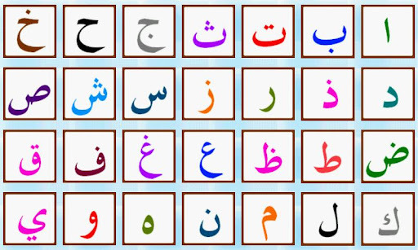
Simple Yet Complicated

